Slide 1
Week - 4
Presented by:
Shafin Bin Hamid
Lecturer
Department of Electrical and Electronics Engineering
Bangladesh University of Engineering and Technology

Slide 2
Outline
Capacitors
Inductors
Source free RC circuits
Source free RL circuits
Singularity function

Slide 3
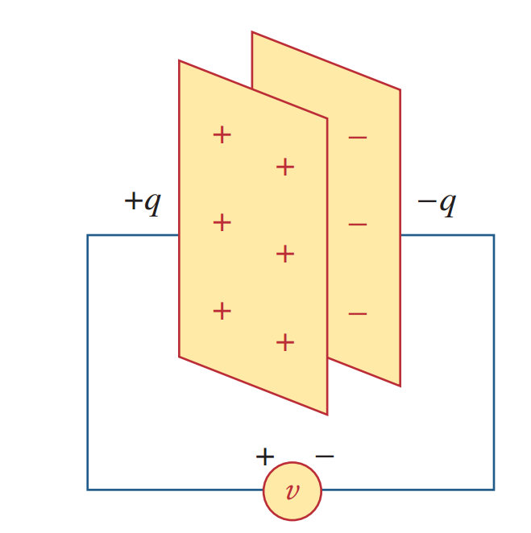
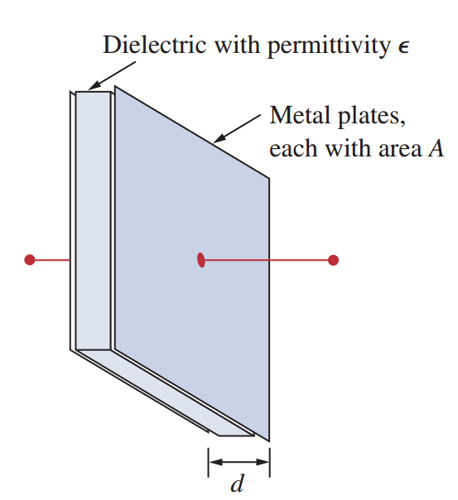

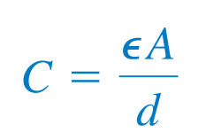
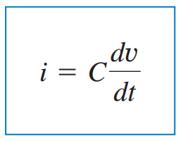
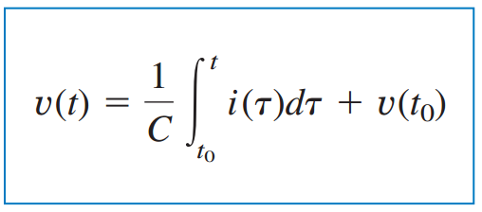
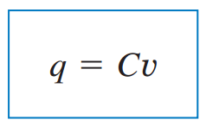
Capacitor

Slide 4
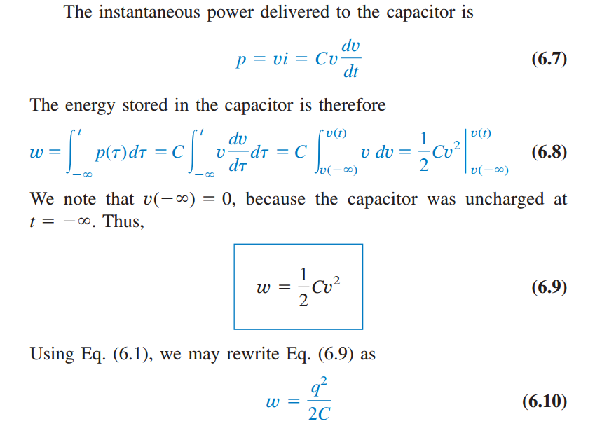
Capacitor

Slide 5
Capacitor
Properties of a capacitor:
A capacitor behaves like an open circuit in DC
The voltage across a capacitor does not change abruptly
The ideal capacitor does not dissipate energy

Slide 6

Problems

Slide 7

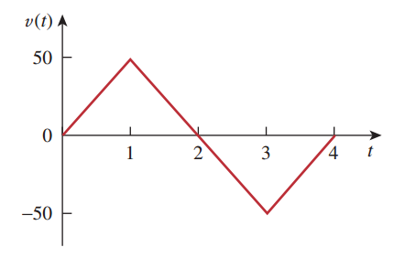
Problems

Slide 8

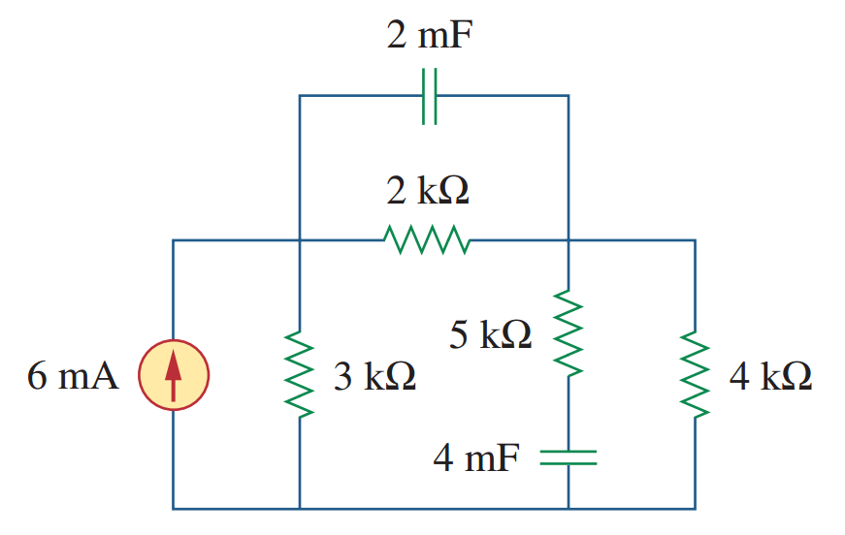
Problems

Slide 9


Parallel combination of capacitors

Slide 10
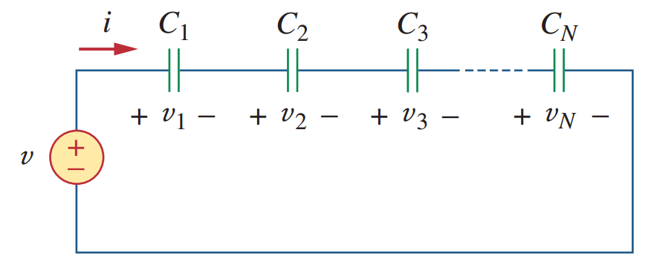

Series combination of capacitors

Slide 11
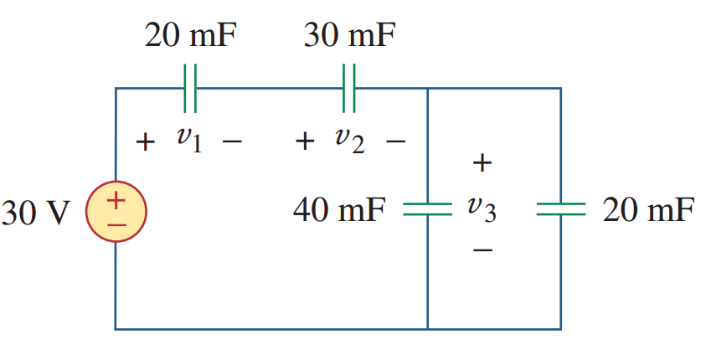
Problems

Slide 12
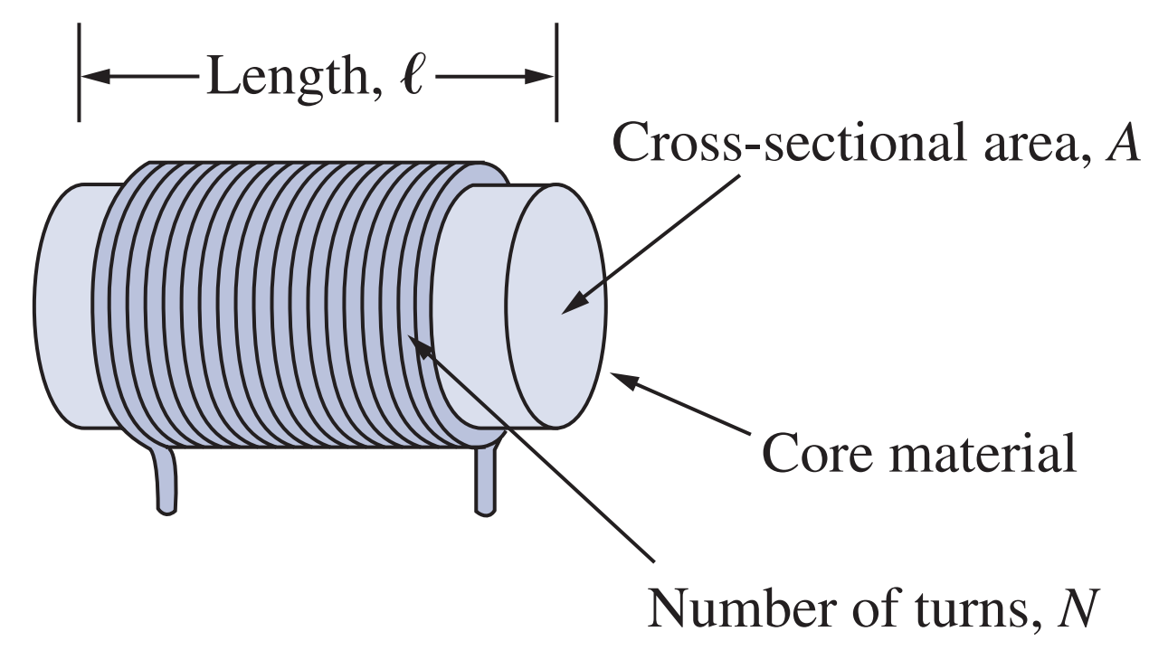
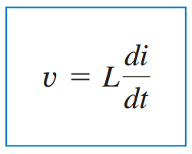
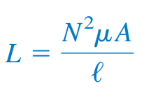
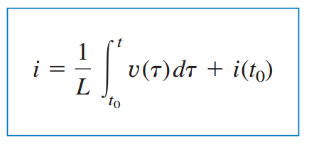
Inductor

Slide 13
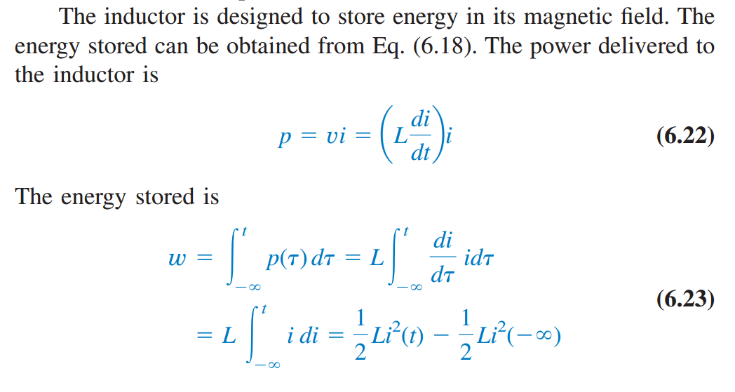

Inductor

Slide 14
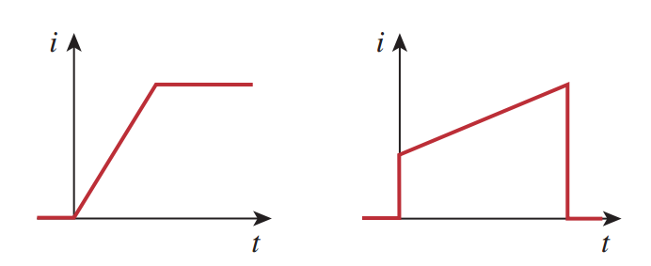
Inductor
Properties of an inductor is as follows:
An inductor acts as a short circuit in DC
The current through an inductor cannot change abruptly
An ideal inductor does not dissipate energy

Slide 15

Problems

Slide 16

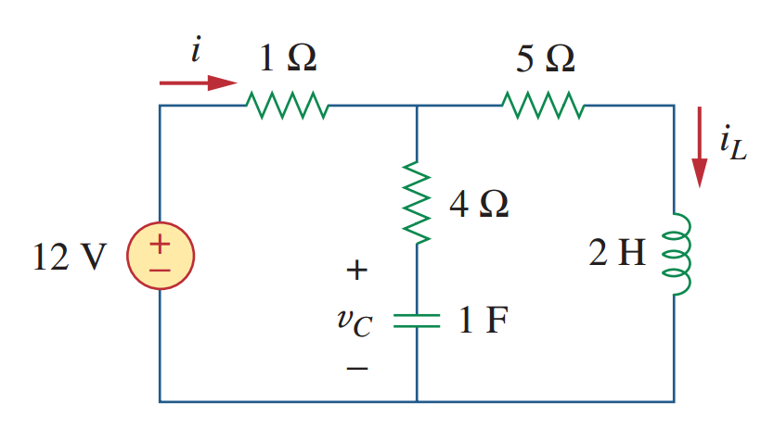
Problems

Slide 17
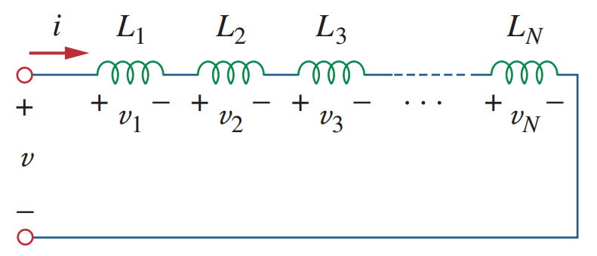

Series combination of Inductors

Slide 18
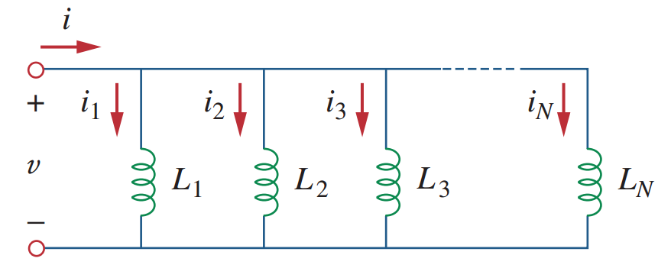

Parallel combination of Inductors

Slide 19

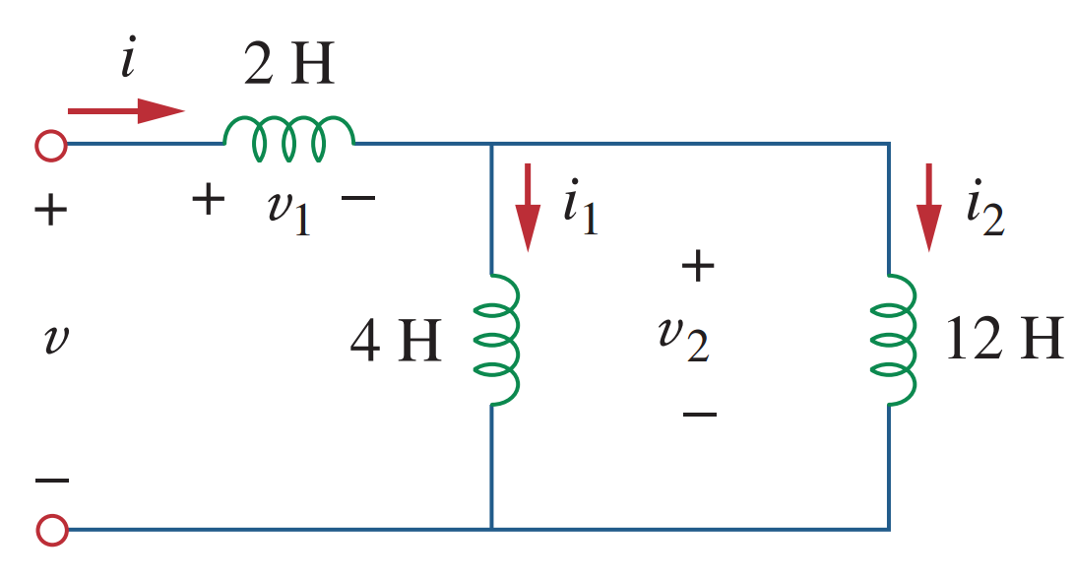
Problems

Slide 20


